Slide 1
Airline Passenger Satisifaction
Created By Mark Cheung

Slide 2
Description on dataset
Data source come from:
https://www.kaggle.com/datasets/teejmahal20/airline-passenger-satisfaction
A single table with 129,880 records, with 24 variables

Slide 3
Variables on dataset
ID,Unique passenger identifier
Gender,Gender of the passenger
#’Female’,’Male’
Age,Age of the passenger
Customer Type,Type of airline customer
#'First-time', 'Returning'
Type of Travel,Purpose of the flight
# Business Travel/Personal Travel
Class,Travel class in the airplane for the passenger seat
#'Business', 'Economy', 'Economy Plus'
Flight Distance,Flight distance in miles
Departure Delay,Flight departure delay in minutes
Arrival Delay,Flight arrival delay in minutes

Slide 4
Variables on dataset (survey)
from 1 (lowest) to 5 (highest) - 0 means ""not applicable"""
Departure and Arrival Time Convenience
Ease of Online Booking
Check-in Service
Online BoardingGate Location
On-board Service
Seat Comfort
Leg Room Service
Cleanliness
Food and Drink
In-flight Service
In-flight Wifi Service
In-flight Entertainment
Baggage Handling
Satisfaction,Overall satisfaction level with the airline (Satisfied/Neutral or unsatisfied)

Slide 5
Insights from dataset
Which percentage of airline passengers are satisfied? Does it vary by customer type?
How flight distance and arrival delay affect customer satisfaction?
Which factors contribute to customer satisfaction the most? Would the needs different on “Business” and “Economy” passengers?
Which factors provides positive relations towards satisfaction?

Slide 6
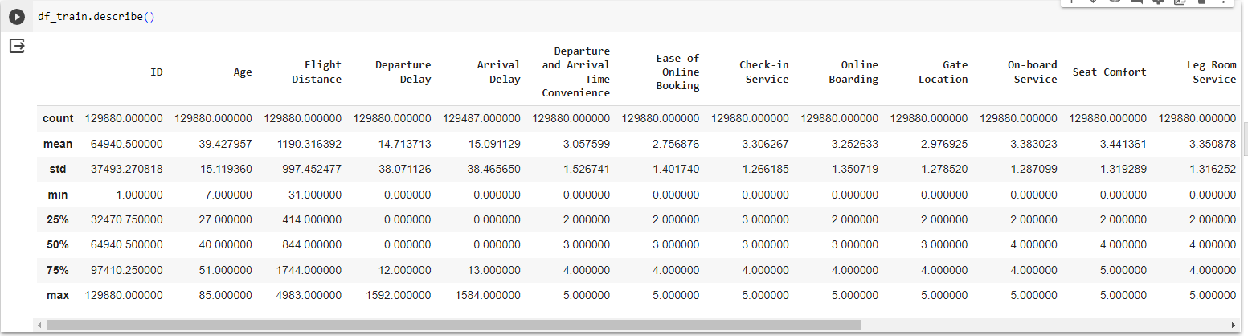
Data Cleansing
Fill in zero for the missing values on ‘Arrival Delay’
Replace the zero values by ‘3’

Slide 7
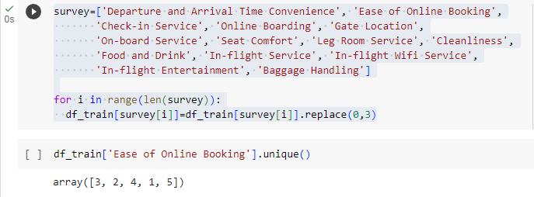

Data Cleansing
Replace the zero values by ‘3’
Changes on dependent variable

Slide 8
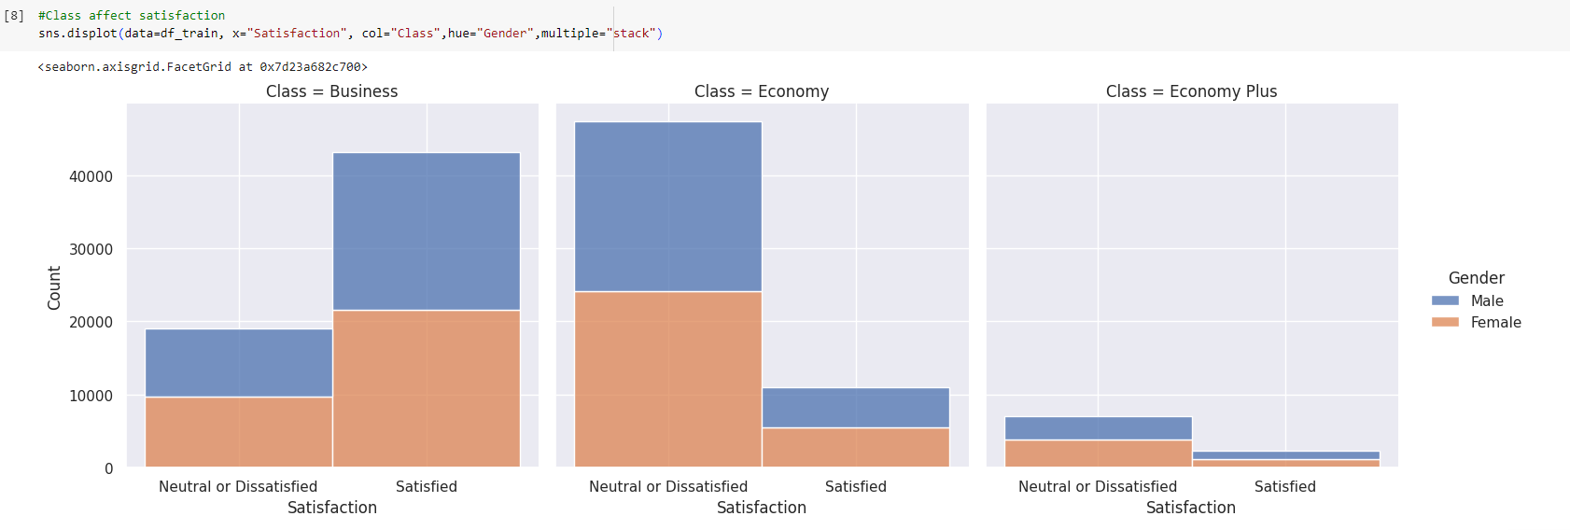
Satisfaction along different Classes
Regardless the gender, more passenger found to be “Satisfied” on “Business” Class

Slide 9
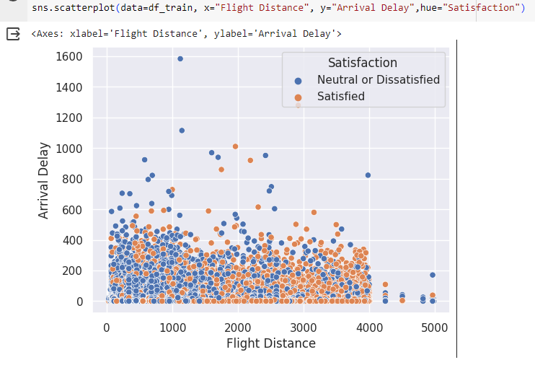
Satisfaction on Flight Distance and Arrival Delay
Passenger more likely to be “Satisfied” with long Flight Distance and low Arrival Delay

Slide 10

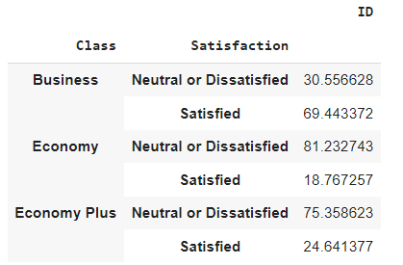
Overall satisfaction
Overall satisfaction=43%
By Class

Slide 11
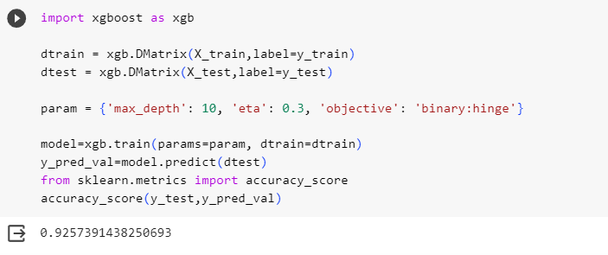
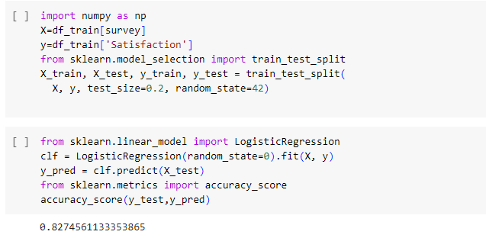
Machine Learning Model
Use of xgboost to obtain a higher accuracy

Slide 12
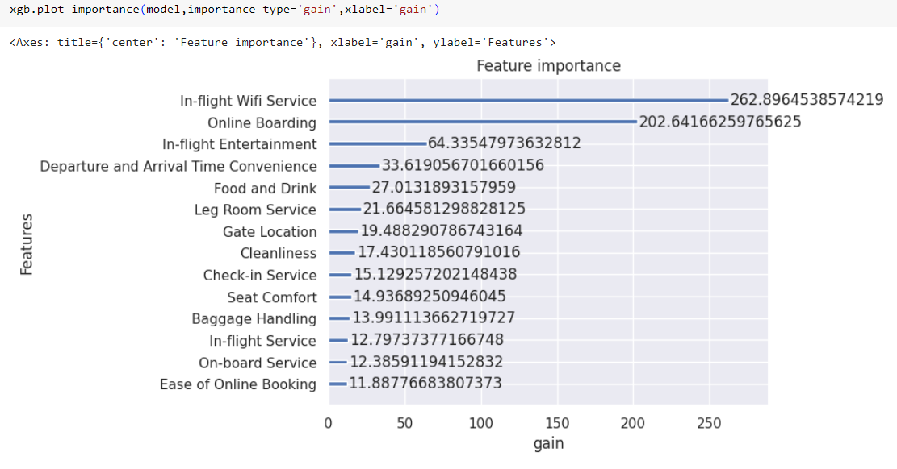
Which factors contribute to customer satisfaction the most?

Slide 13
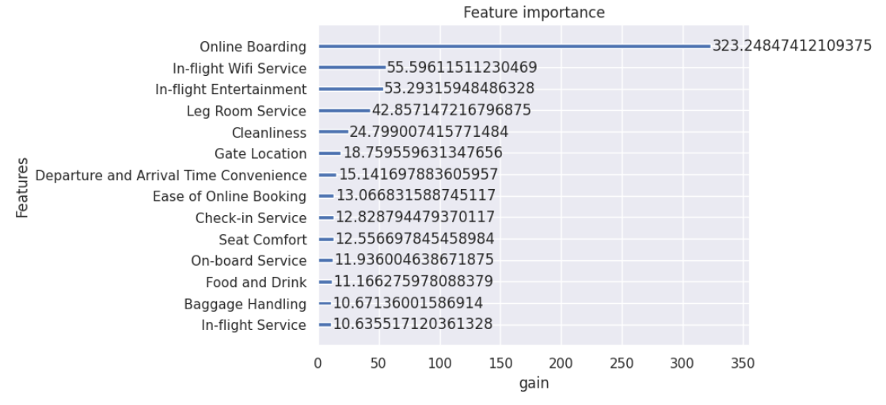
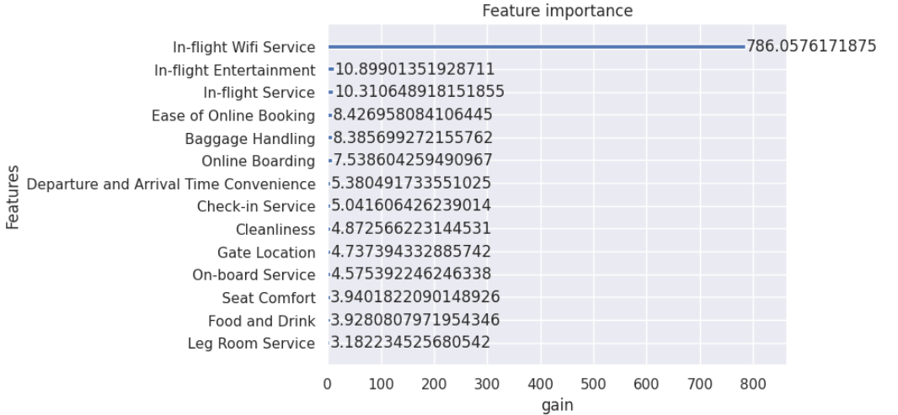
Would the factors varies by customer type?
Business passenger weight more on Online Boarding
Economy passenger weight more on In-flight Wifi Service

Slide 14
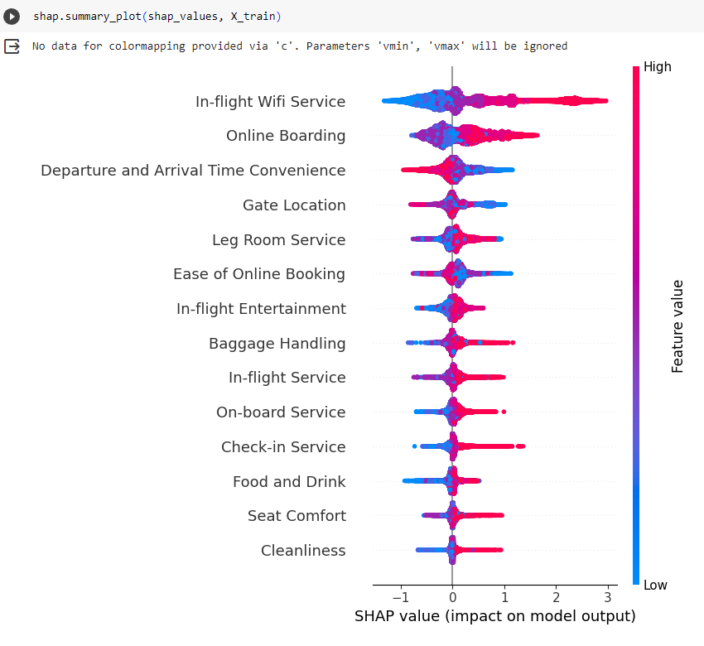
How factors affect the satisfaction score

Slide 15
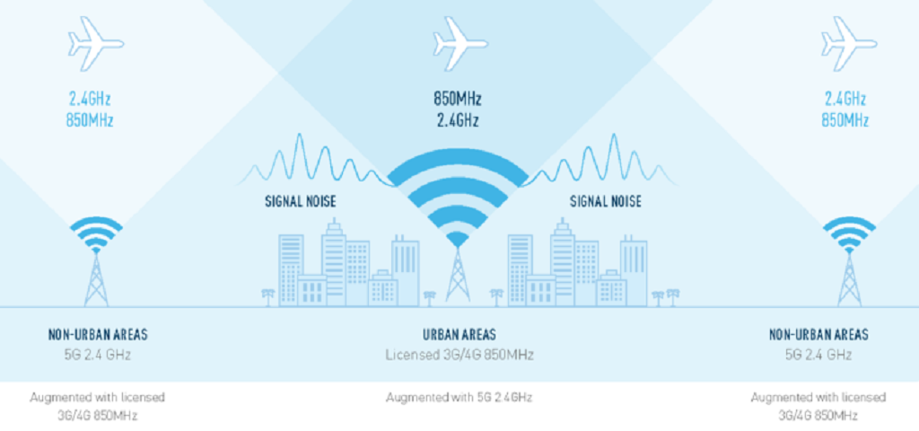
Feasibility on improving Inflight Wi-Fi service
https://youtu.be/j0ubldGE2-k?si=mu__cszCeY6vfXAi

Slide 16
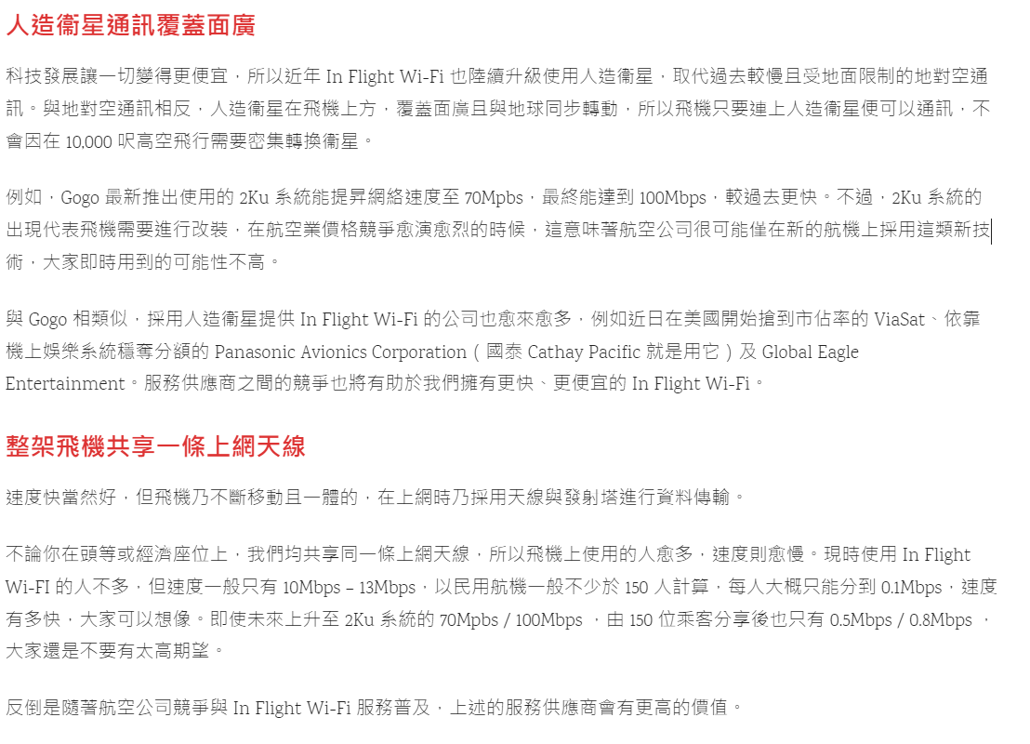
Feasibility on improving Inflight Wi-Fi service

Slide 17
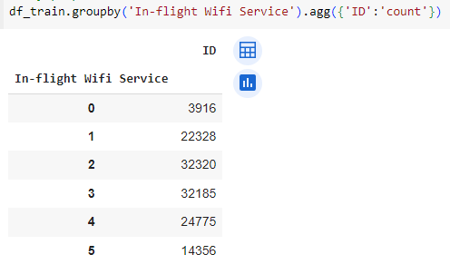
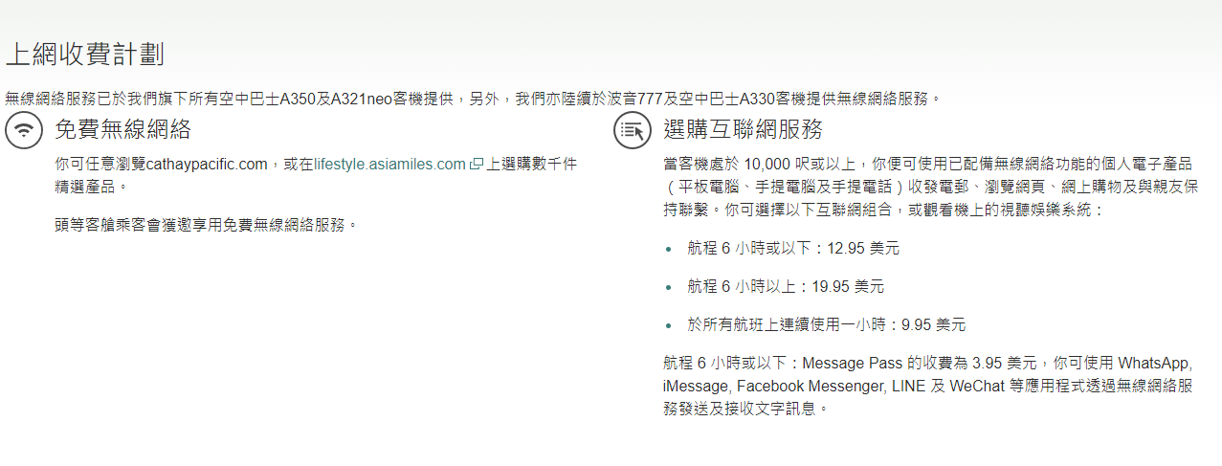




Suggestions to Inflight Wi-Fi Service
The “Zero” value is too low along dataset
Eligibility towards Wi-Fi Service
Class, flight distance, data usage
(Source:Cathy Pacific)

Slide 18
Reference
Kaggle-Airline Passenger satisfaction
https://www.kaggle.com/datasets/teejmahal20/airline-passenger-satisfaction
Youtube- How Gogo Inflight Internet Works
https://www.youtube.com/watch?v=j0ubldGE2-k&ab_channel=GogoInflight
【詳解】你知道「飛機 WiFi」 原理是什麼？速度變快又是什麼原因？
https://www.techritual.com/2023/07/20/235538/

